Slide 1
Onera satellite dataset summary

Slide 2
Images numbers
The dataset consists of 24 pairs of images split in
14*2 images for training
10*2 images for testing
with various dimension, ranging from 1070*1180 to 385*241
Each image is split in 13 .tif «layer» files, both raw (with different dimensions) and cropped + upsampled at 10m per pixel («rect» version)
The provided training and test labels are both in .tif and .png format
0/1 (2/1) and 255/0 stand respectively for changed/not changed
the labels contain only indication on pixel change because of urban transformation, ignoring natural aspects.
A model trained on this dataset can learn to detect only urban changes

Slide 3
When the images were taken
Samples were created between 4° of july 2015 and 2° of april 2018
Almost all the pair are shoot in different seasons and at a different time of day (see Bercy as reference)
5 pairs were sampled in the same season (Chongquing, Milan, Beihai, Paris, Rennes)
Saclay_w and Saclay_e were taken the same day
The first image and the second of each pair were taken, in average, 650 days from each other (953 days for the furthest pair – Pisa, 272 days for the closest – bercy)

Slide 4
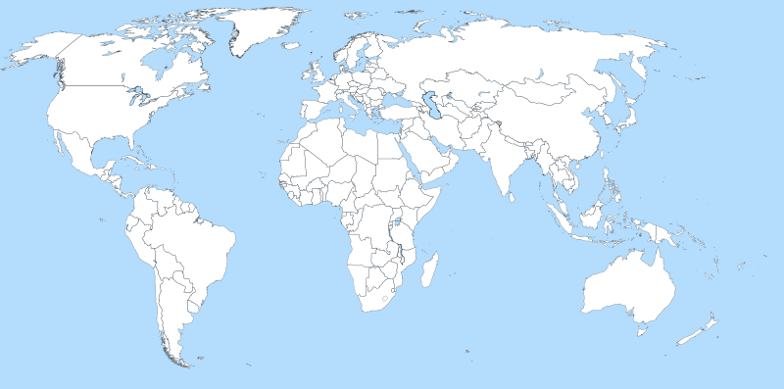
Where the images were taken
Abu Dhabi
Aguas Claras
Beihai
Beirut
Bercy (Paris)
Bordeaux
Brasilia
Chongquing
Cupertino
Dubai
Hong Kong
Las Vegas
Milan
Montpellier
Mumbai
Nantes
Norcia
Paris
Pisa
Rennes
Rio
Saclay (East and West)
Valencia
test
training
Bercy + Paris + Saclay

